Slide 1



The Whys of the LOIS:
Credit Skew and Funding Rates Volatility
Raphaël Douady Riskdata and CNRS-Univ. Paris 1-Sorbonne
EFFAS European Bond Commission
Paris Euronext Feb 11, 2013
Joint work with Stéphane Crépey

Slide 2
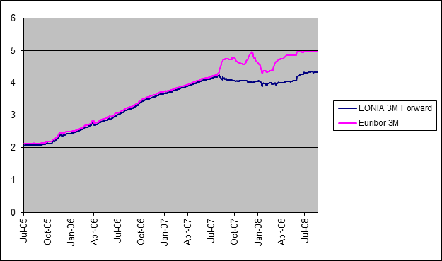
Feb 11, 2013
<number>
Euribor vs. O/N 3M Swap
A sudden divergence appeared with 2007 liquidity crisis
It still persists today.
Douady-Crepey: The Whys of the LOIS

Slide 3
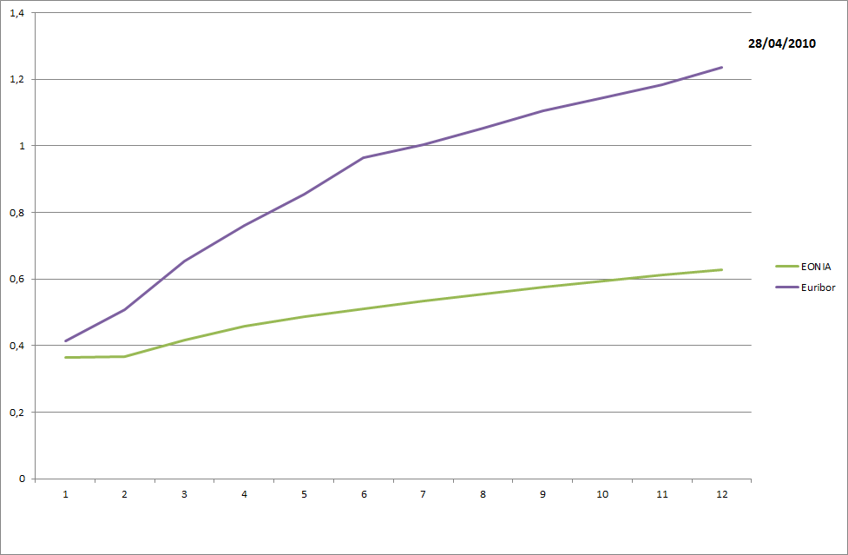
Feb 11, 2013
<number>
LOIS Term Structure
The longer the maturity, the larger the spread
  Data as of Apr 28, 2010
Douady: The Whys of the LOIS

Slide 4
Feb 11, 2013
<number>
LOIS Classical Explanation
Studies by:
  Schwartz (2010)
  Taylor and Williams (2009)
  McAndrews, Sarkar and Wang (2008)
  Michaud and Upper (2008)
  Eisenschmidt and Tapking (2009)
Credit component + Liquidity component
  Statistical decomposition of the signal
  Credit = Bank CDS assumed liquid, hence no liquidity component
  Remainder = “liquidity component”
One cannot assume that CDS are liquidity-free
  Risk premium, Cost of capital…
  Bond credit spread vs. CDS widening during liquidity crises
Douady: The Whys of the LOIS

Slide 5
Feb 11, 2013
<number>
Bond Spread vs. CDS
─ Financials
─ Non Financials
July 2007
Subprime Crisis
Douady: The Whys of the LOIS

Slide 6
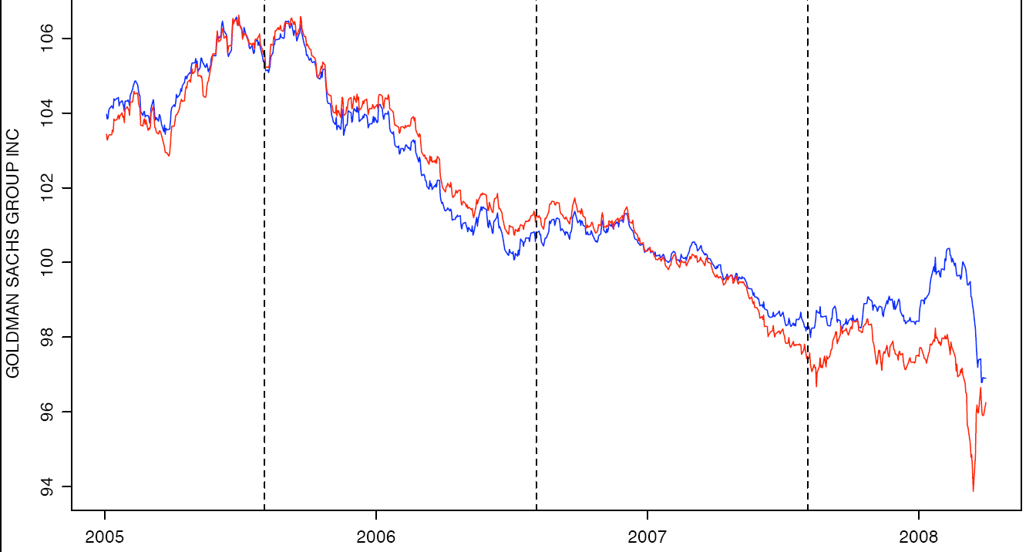
Feb 11, 2013
<number>
Bond Price vs. CDS Implied
─ Actual
─ From CDS
Subprime Crisis
Douady: The Whys of the LOIS

Slide 7
Feb 11, 2013
<number>
LOIS Fundamental Approach
Amount N, Rate L
Bank
Counterparty
Period T
Bank’s Choice
  Lending at LIBOR on a fixed period T : capital is locked
  Lending on rolling Overnight at a revisable rate : can discontinue lending
Liquidity Constraints
  Unsure of the amount of liquidities it may need during period T
  Refinancing rate depends on this amount and own CDS
  Basel III: Capital Adequacy + Liquidity Ratio
  Changes in Central Bank lending policy
Counterparty Credit Risk
  Borrower’s rating may downgrade during period T
  Default risk, Contagion from others default
Douady: The Whys of the LOIS

Slide 8
Feb 11, 2013
<number>
Funding Cost
Capital mobilized for lending has a Cost
  Lending O/N gives the option to stop if capital too expensive
  Cap option on the cost of capital
Bank’s Borrowing rate ρ = f(t, S, D/C)
  t = current date
  S = Bank’s credit spread
  D = Short-term debt
  C = Capital
Marginal cost of capital: cost of an increase of D
ρ′ = ∂ρ/∂D
Example: ρt(D + x) = St + A Dt/Ct + B St x
ρt′ = B St
Douady: The Whys of the LOIS

Slide 9
Feb 11, 2013
<number>
Equilibrium Model
Optimizing O/N Lending Profit
  Nt = Amount lent at date t ∈ [0, T]
  K = Lending rate (assumed fixed)
Optimizing LIBOR Term Lending Profit
  N = Fixed amount
  L = Lending rate
  τ = Counterparty “stylized” default time: difference between term default risk and overnight “surprise”
Douady: The Whys of the LOIS

Slide 10
Feb 11, 2013
<number>
Equilibrium Model
Assume that O/N rate K is imposed by the Market
  Assumed fixed, but generalization to time-dependent rate is easy
Optimal profit for rolling O/N lending
U(K) = max(Nt) U(K,(Nt))
Optimal profit for LIBOR term lending
V(L) = maxN V(L, N) < U(L)
Equilibrium: find term lending rate L*I such that:
V(L*) = U(K)
LOIS = L* – K
  Model valid for one bank, but LIBOR determination is an average of which each component follows this logic.
Douady: The Whys of the LOIS

Slide 11


Feb 11, 2013
<number>
Equilibrium Model
Linear Approximation
ρt(D + x) = αt + βt x ρt′ = βt
  Example: αt = St + A Dt/Ct βt = B St
O/N Lending
LIBOR Lending
γt = αt + λt
  λt = “Credit skew” = intensity of τ : counterparty’s CDS curve slope
Douady: The Whys of the LOIS

Slide 12




Feb 11, 2013
<number>
Overnight Optimization
At time t
Expected profit
Douady: The Whys of the LOIS

Slide 13



Feb 11, 2013
<number>
LIBOR Optimization
Particular cases:
  Nt = constant
  λt = 0
⇒ U(K) ≥ Vλ=0(K) ≥ V(K)
Douady: The Whys of the LOIS

Slide 14





Feb 11, 2013
<number>
LOIS Computation
If we have V(L*) = U(K) then
Douady: The Whys of the LOIS

Slide 15




Feb 11, 2013
<number>
LOIS Computation
Particular Case K = =‾(αt lt) /‾(lt)
Approximation
Credit component
Liquidity component
Douady: The Whys of the LOIS

Slide 16


Feb 11, 2013
<number>
LOIS Computation
Implied Funding Rate Sensitivity and Volatility
Term structure of LOIS
Douady: The Whys of the LOIS

Slide 17
Feb 11, 2013
<number>
LOIS Decomposition
LIBOR(T) – OIS(T) = α + β√T
Credit Skew = Term CDS – O/N CDS
Cost of Capital = Cap on Funding Cost
Interbank Credit Skew
Liquidity
Cost of Capital
Douady: The Whys of the LOIS

Slide 18
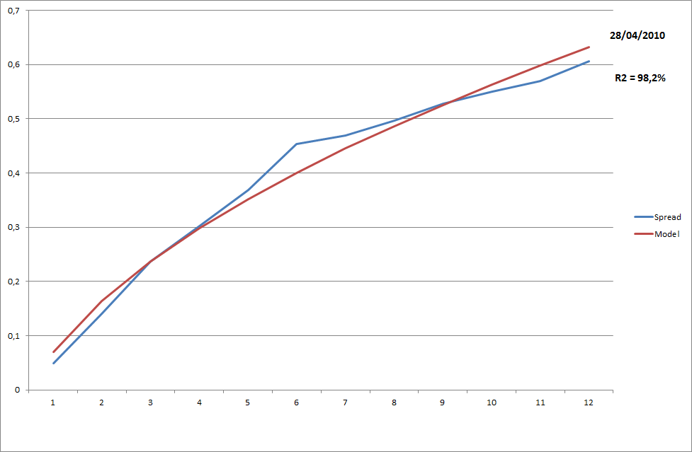
Feb 11, 2013
<number>
LOIS Term Structure
Square-root fit of the LOIS as of Apr 28, 2010
Douady: The Whys of the LOIS

Slide 19
Feb 11, 2013
<number>
LOIS SQRT-Fit
2011 Crisis
2008 Crisis
Douady: The Whys of the LOIS

Slide 20
Feb 11, 2013
<number>
References
Bean, C. (2007). An Indicative Decomposition of Libor Spreads. The Bank of England, Quarterly Bulletin 47 (4), 498-99.
Brunnermeier, M. and L. Pedersen (2009). Market Liquidity and Funding Liquidity. The Rev. of Financial Studies 22 (6), 2201-38.
Crépey, S. (2012a). Bilateral Counterparty risk under funding constraints - Part I: Pricing. Part II: CVA, Mathematical Finance. Forthcoming.
Crépey, S., Z. Grbac, and H. N. Nguyen (2012). A multiple-curve HJM model of interbank risk. Mathematics and Financial Economics 6 (3), 155-190.
Eisenschimdt, J. and J. Tapking (2009). Liquidity Risk Premia in Unsecured Interbank Money Markets. Technical Report 1025, ECB Working Paper Series.
Filipovic, D. and A. B. Trolle (2011). The term structure of interbank risk. SSRN eLibrary.
Morini, M. (2009). Solving the puzzle in the interest rate market. SSRN eLibrary.
Pallavicini, A., D. Perini, and D. Brigo (2012). Funding, collateral and hedging: uncovering the mechanics and the subtleties of funding valuation adjustments. Preprint, arXiv:1210.3811.
Wheatley, M. (2012). The Wheatley Review of LIBOR: final report. Technical report.
Douady: The Whys of the LOIS

